Slide 1
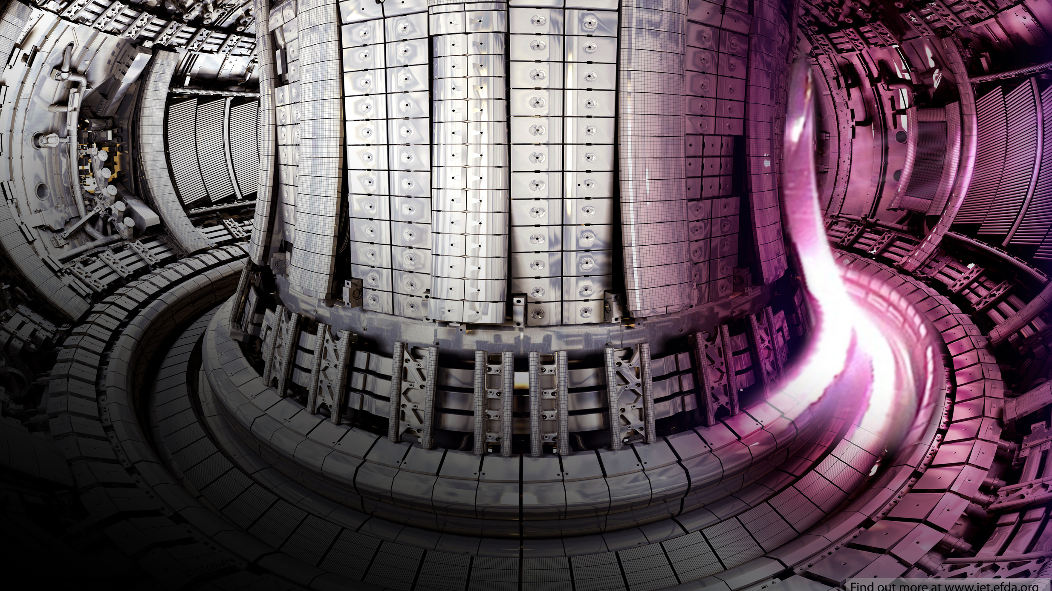
Optimising Tritium Production in Fusion Breeder Blankets
Vadan Khan and Rhodri Peters
Semester 1 Masters presentation

Slide 2
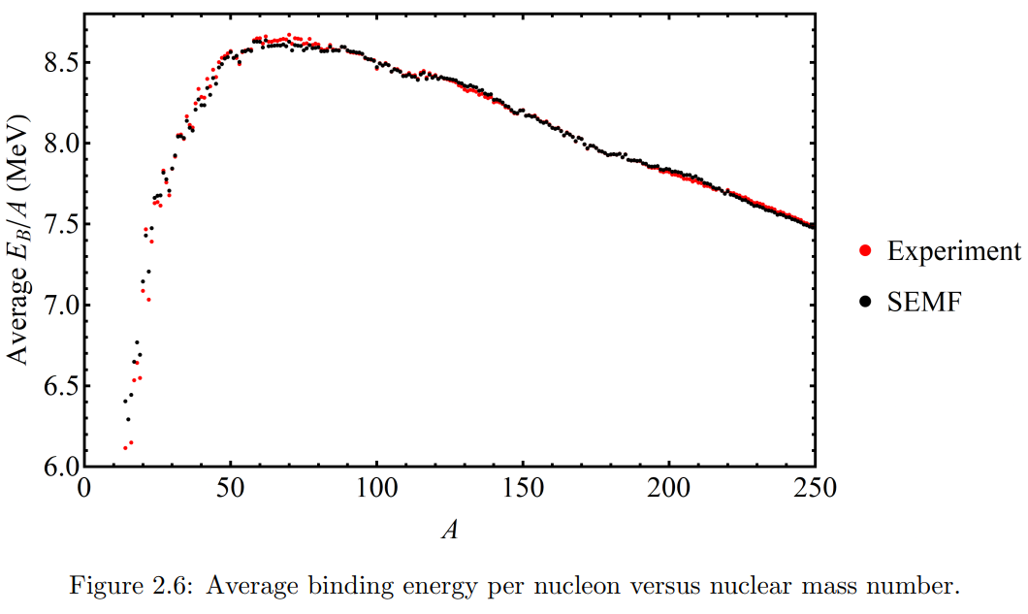
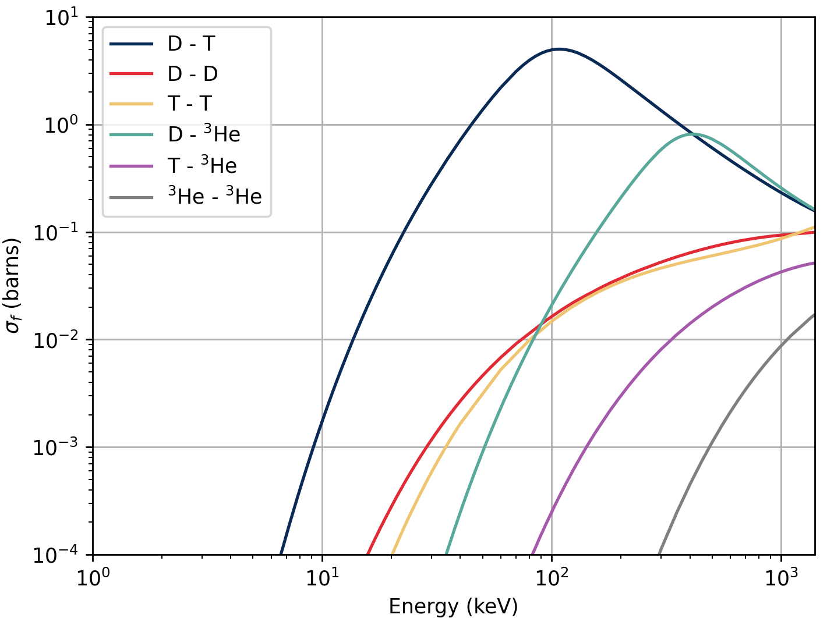
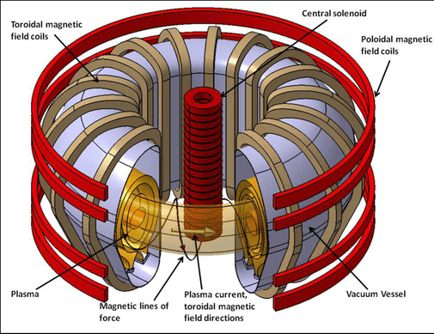
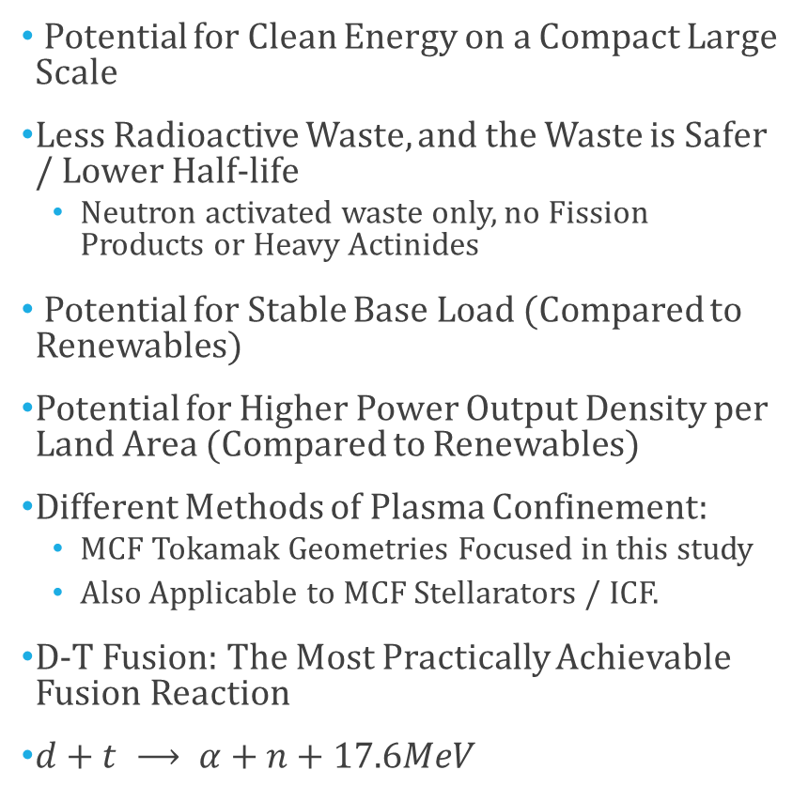
Introduction to Fusion
Nuclear Fusion
~3 MeV per Nucleon (only ~80% used for heating)
Nuclear Fission
~1 MeV per Nucleon
(But 200MeV per reaction)
Potential for Clean Energy on a Compact Large Scale
Less Radioactive Waste, and the Waste is Safer / Lower Half-life
Neutron activated waste only, no Fission Products or Heavy Actinides
Potential for Stable Base Load (Compared to Renewables)
Potential for Higher Power Output Density per Land Area (Compared to Renewables)
Different Methods of Plasma Confinement:
MCF Tokamak Geometries Focused in this study
Also Applicable to MCF Stellarators / ICF.
D-T Fusion: The Most Practically Achievable Fusion Reaction
$d+t ⟶ α+n+17.6MeV$
Magnetic Confinement Fusion (MCF): Tokamaks

Slide 3
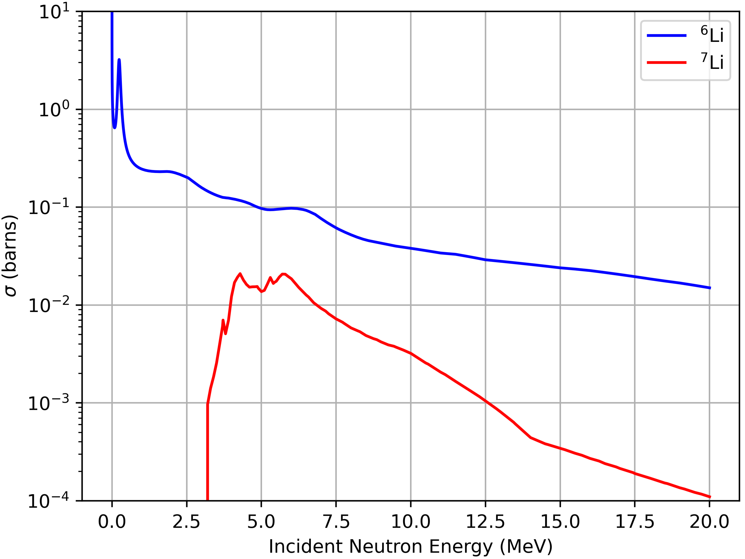
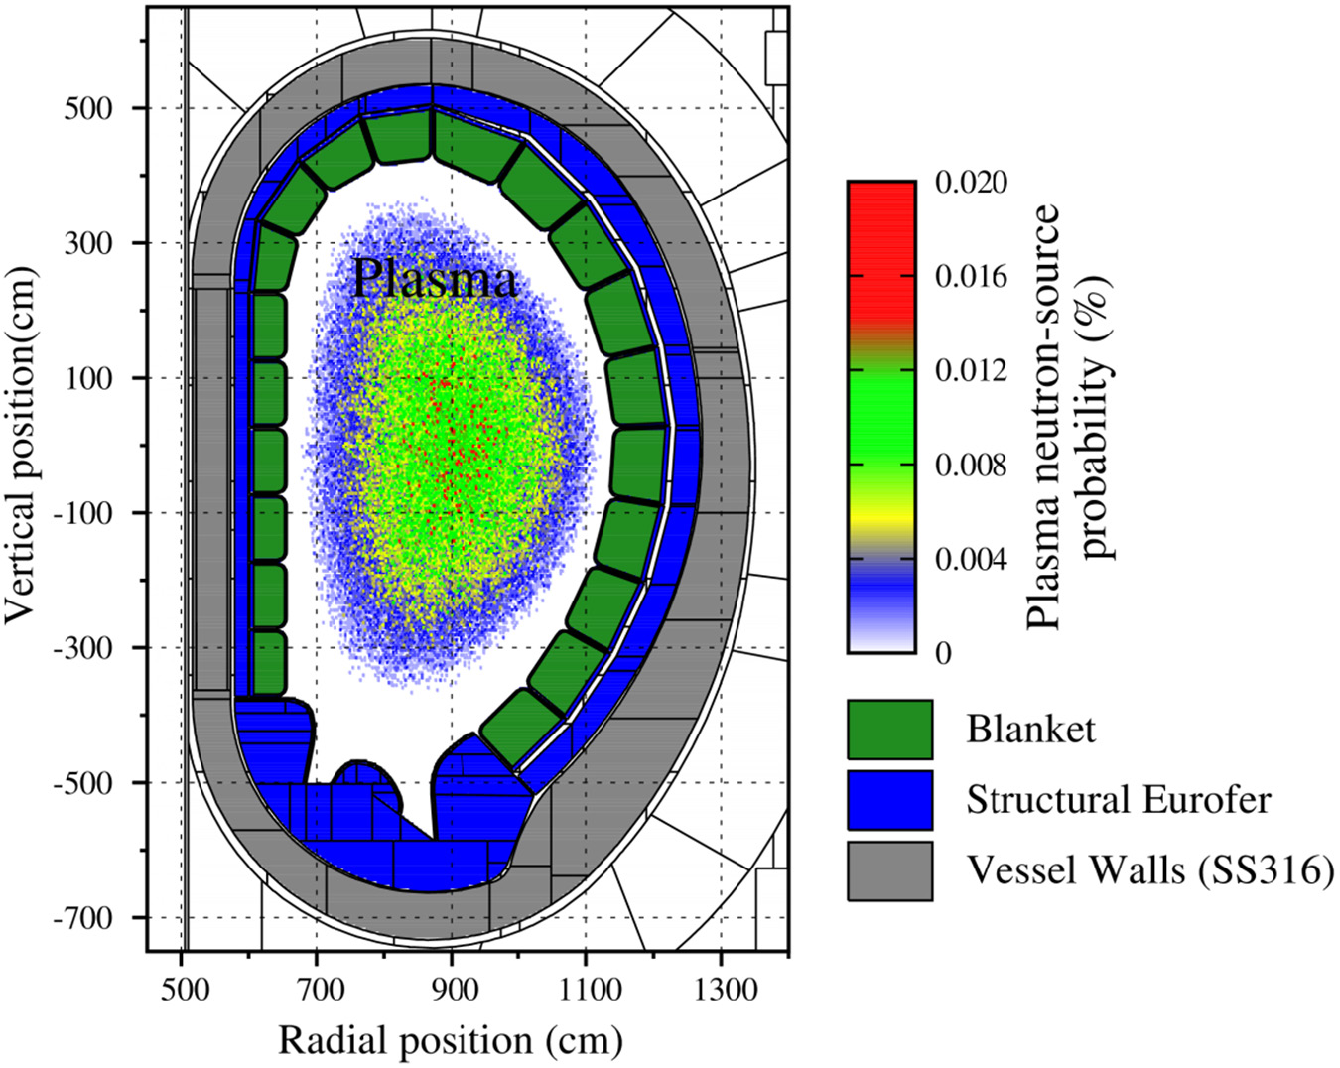
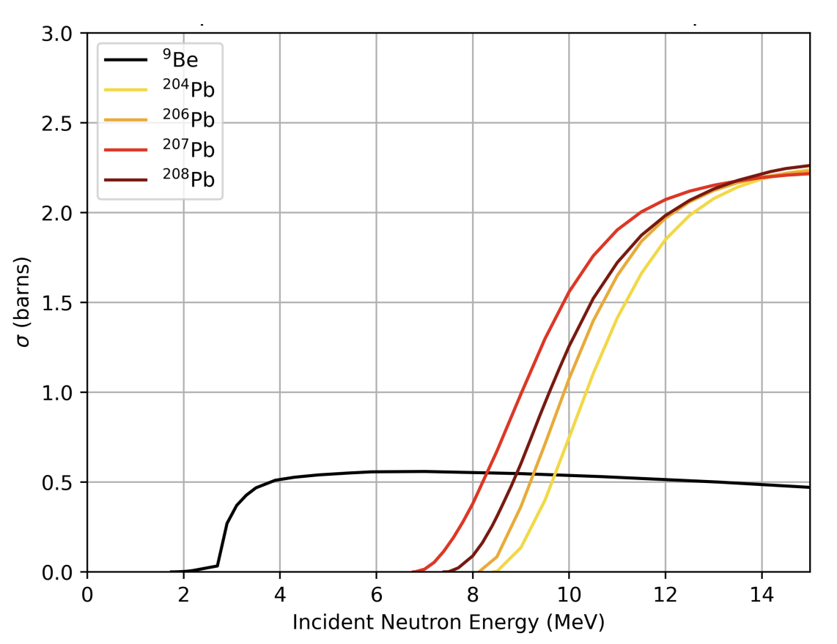
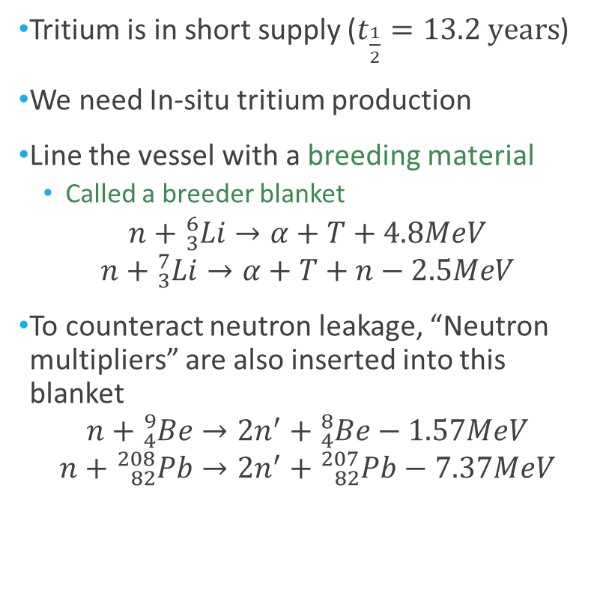
Introduction to Breeder Blankets
Tokamak
Tritium is in short supply ($t_{\frac{1}{2}}=13.2 years$)
We need In-situ tritium production
Line the vessel with a breeding material
Called a breeder blanket
$$n+{}_{3}^{6}{Li}→α+T+4.8MeV$$
$$n+{}_{3}^{7}{Li}→α+T+n−2.5MeV$$
To counteract neutron leakage, “Neutron multipliers” are also inserted into this blanket
$$n+{}_{4}^{9}{Be}→2n^{′}+{}_{4}^{8}{Be}−1.57MeV$$
$$n+{}_{82}^{208}{Pb}→2n^{′}+{}_{82}^{207}{Pb}−7.37MeV$$

Slide 4
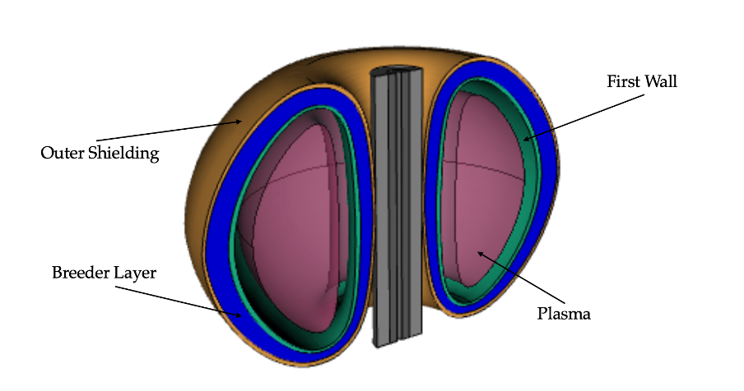
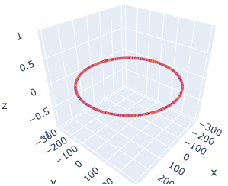

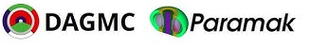
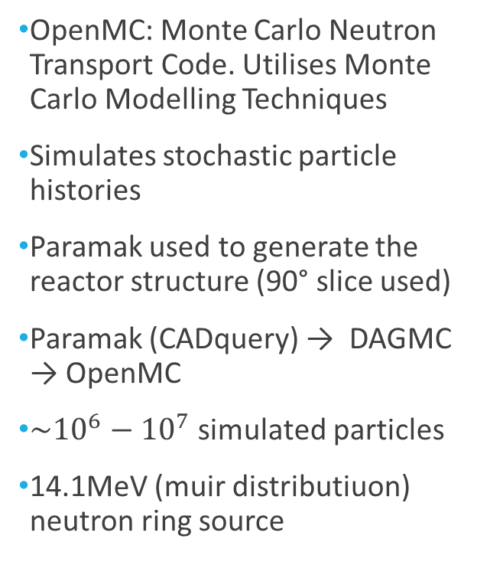
OpenMC and Simulation
OpenMC: Monte Carlo Neutron Transport Code. Utilises Monte Carlo Modelling Techniques
Simulates stochastic particle histories
Paramak used to generate the reactor structure (90° slice used)
Paramak (CADquery) → DAGMC → OpenMC
$\sim {10}^{6}−10^{7}$ simulated particles
14.1MeV (muir distributiuon) neutron ring source

Slide 5
Methodology (remove?)
Parametric sweeps of key attributes:
Base model derived from the available literature
Coolant mixed homogenously within breeder blanket layer.
Material Choices:
Solid Breeder Blankets
Liquid / Molten Salt Breeder Blankets
Neutron Multipliers
Coolant
First wall
Material Composition Sweeps:
Lithium enrichment
Coolant fractions
Multiplier fractions
Geometry Sweeps:
Breeder Blanket Thickness
Triangularity

Slide 6
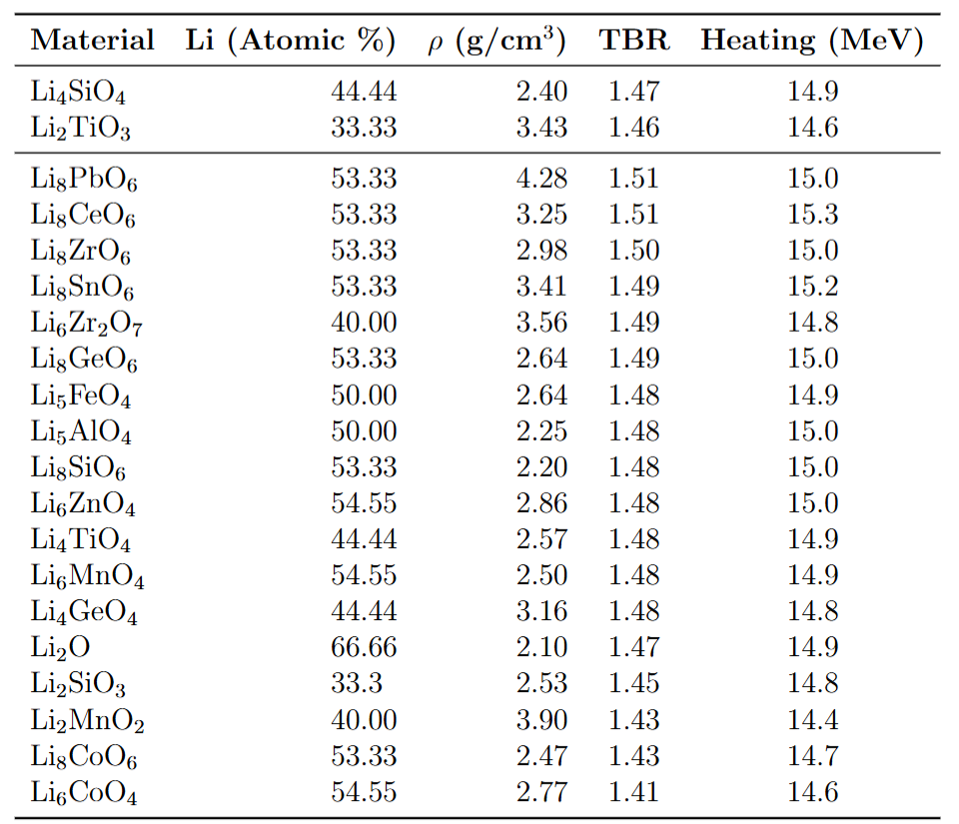
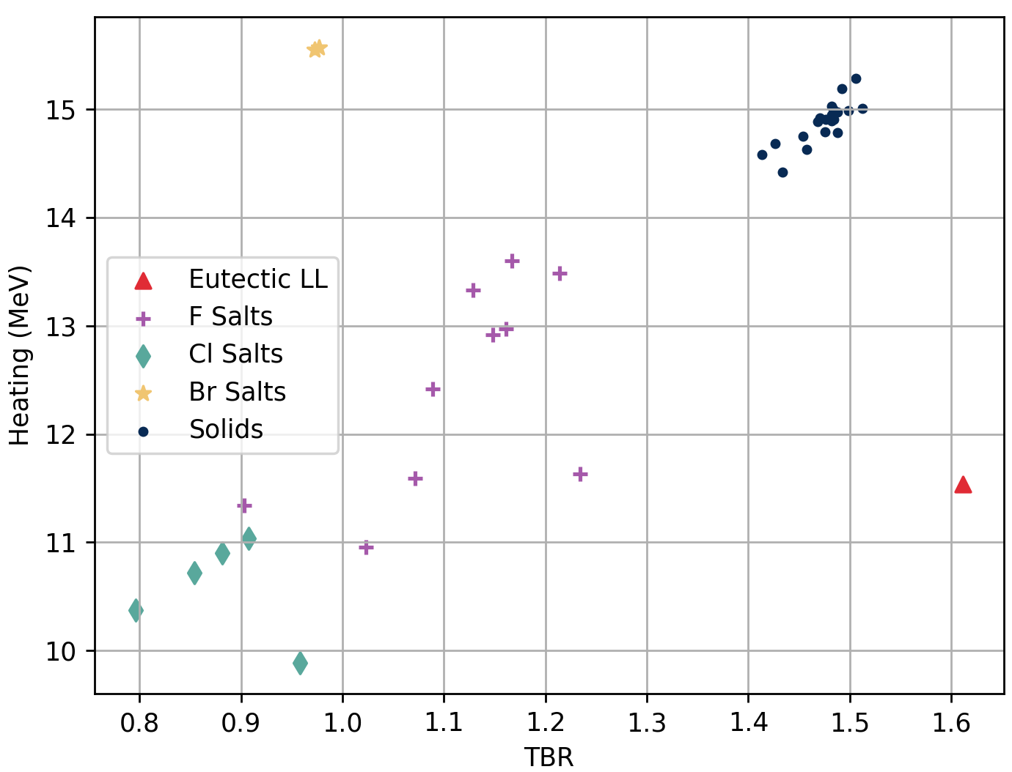
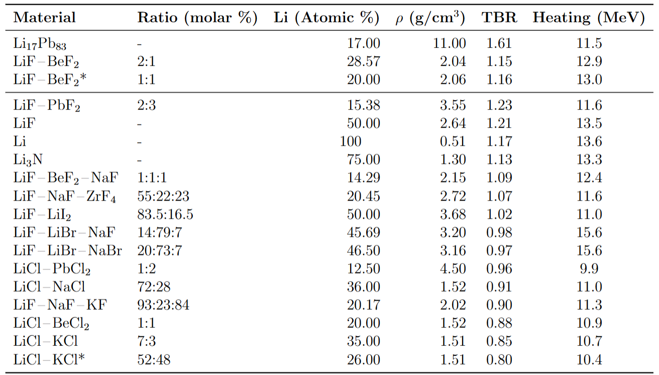
Liquid and Solid Breeder Materials

Slide 7
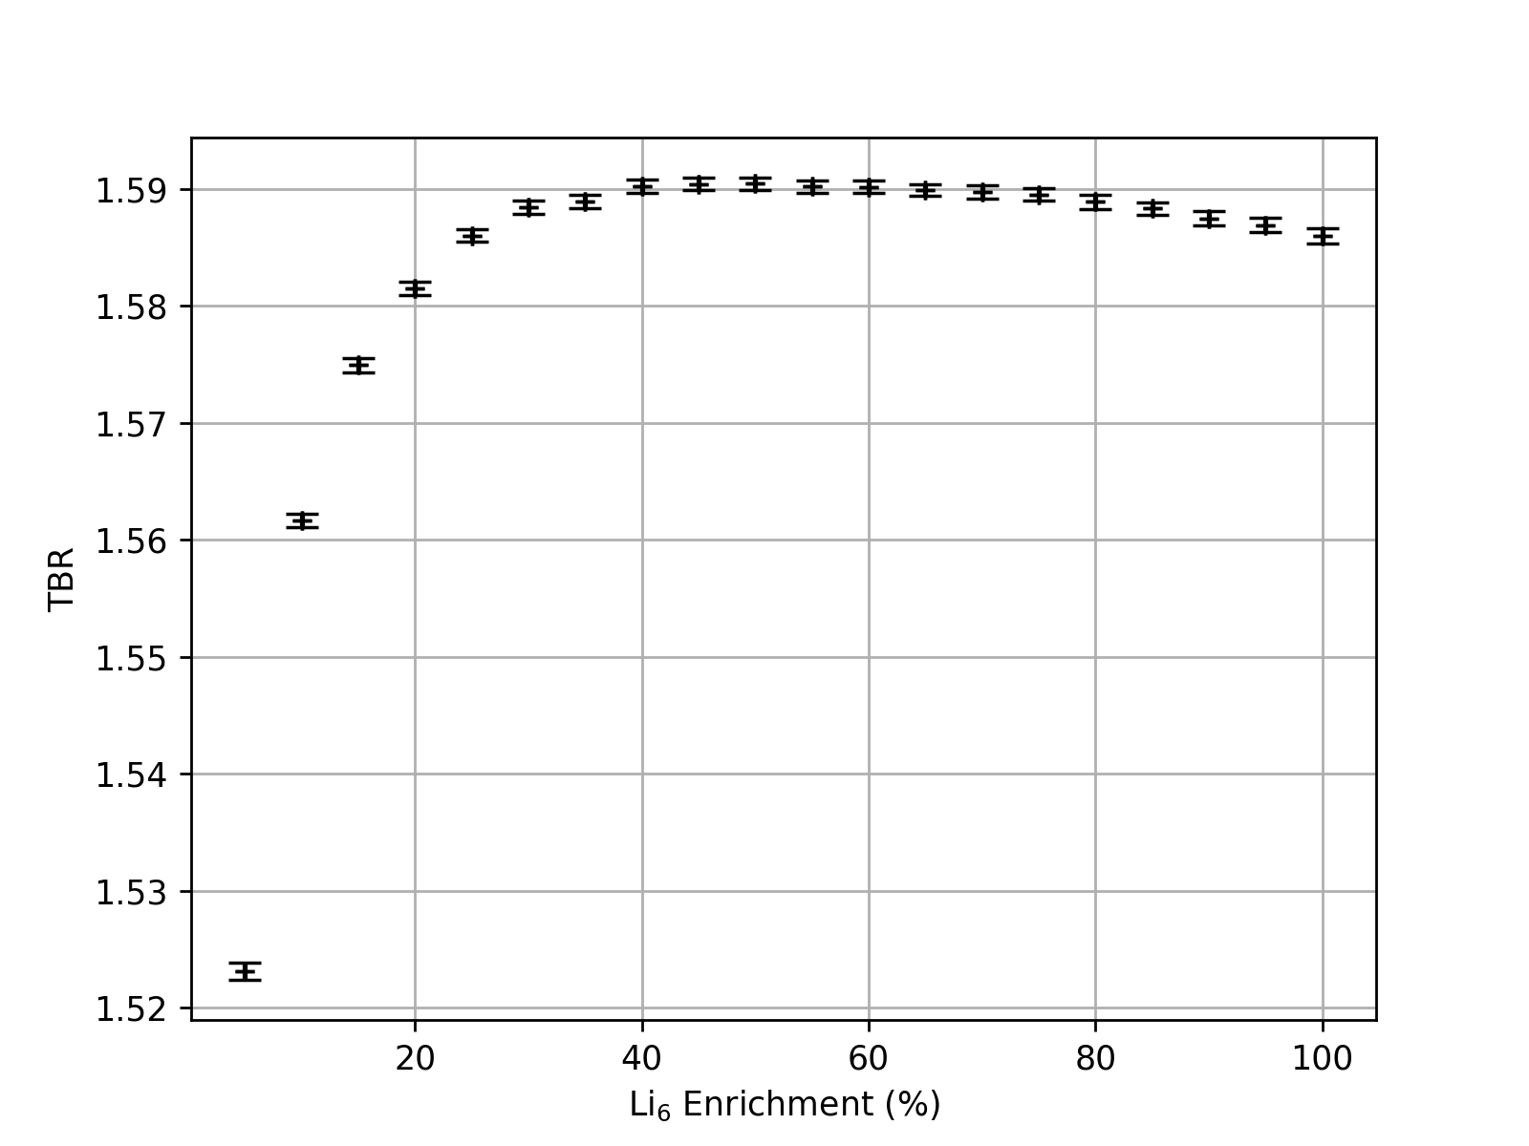
Lithium-6 Enrichment
Literature Values on Enrichment Vary from 40-90%
Our study suggests a saturation at 40%
Even 20 / 30 % could still be largely suitable as a compromise on expensive enrichment costs

Slide 8
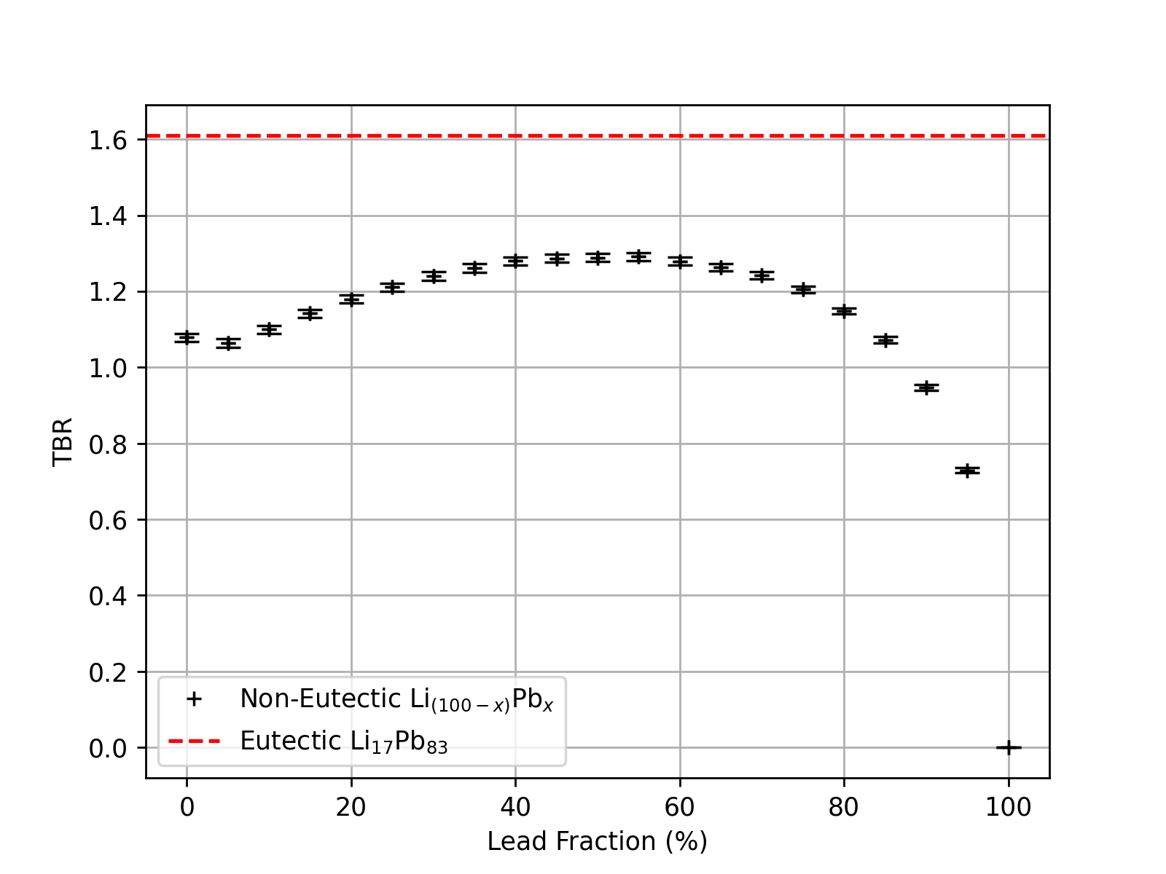
Lithium Lead Multiplier Composition
Basic Study Assuming non-varying Packing Factors
However, the TBR from a full Eutectic LiPb Alloy had far higher TBR.
Mostly due to its higher density
Demonstrates the significance on considering packing factors / density of alloys

Slide 9
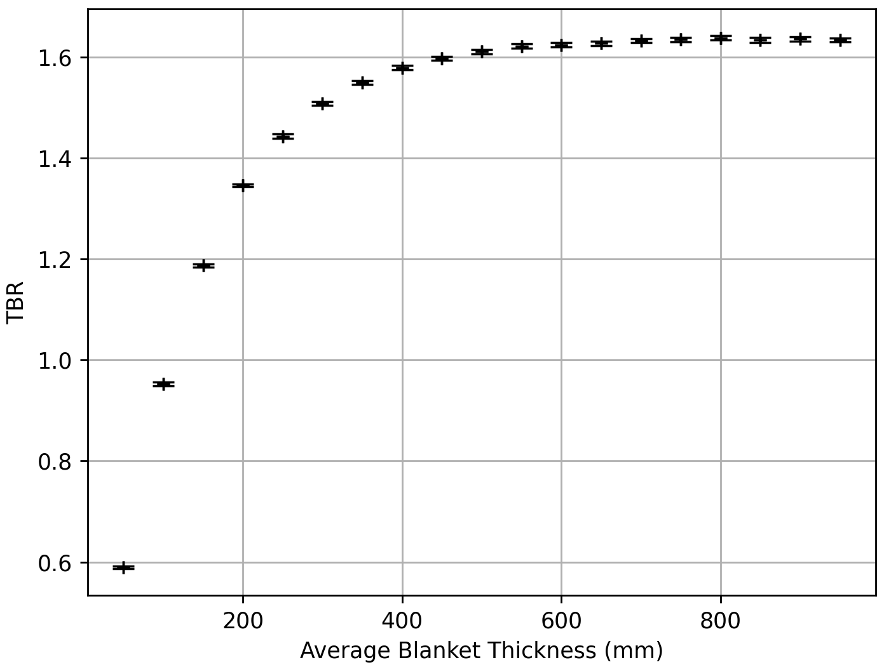
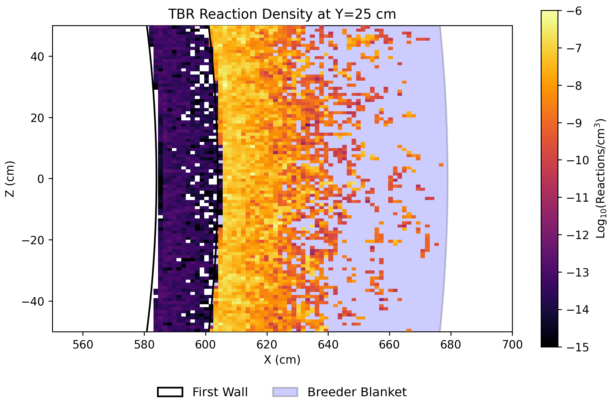
Breeder Blanket Thickness
TBR / Blanket Thickness
TBR Reaction Heatmap
TBR Appears to Saturate at ~ 500mm thickness.

Slide 10
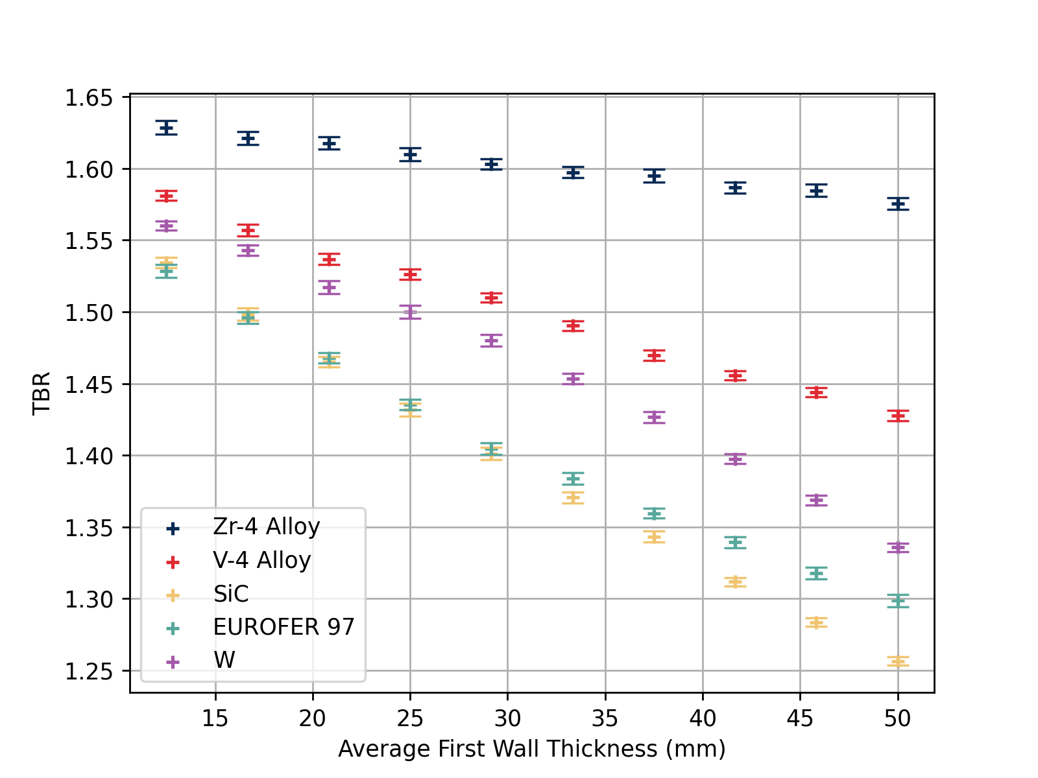
First Wall Thickness
Considering TBR alone, Zirconium Alloy is Far Superior.
However, considerations on Max Thermal Flux limit & Plasma Parameters could shift this choice in a real device.

Slide 11
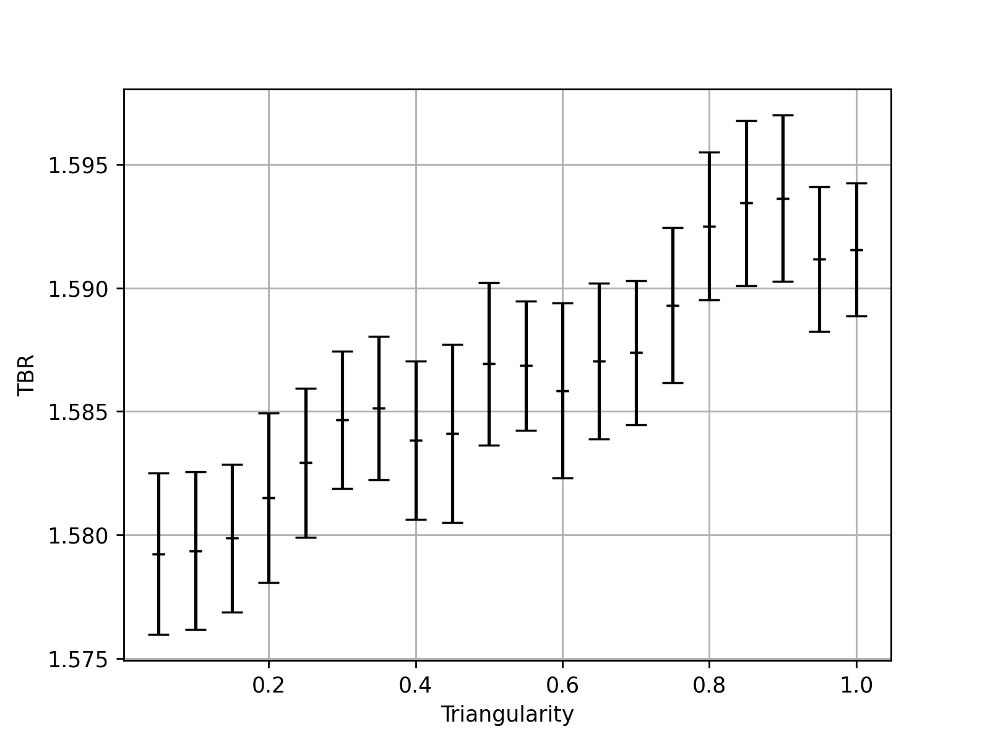
Triangularity
There was negligible variation on TBR against Triangularity
Provides scope for a more advanced plasma source
Body source with density variation as opposed to simple ring source

Slide 12
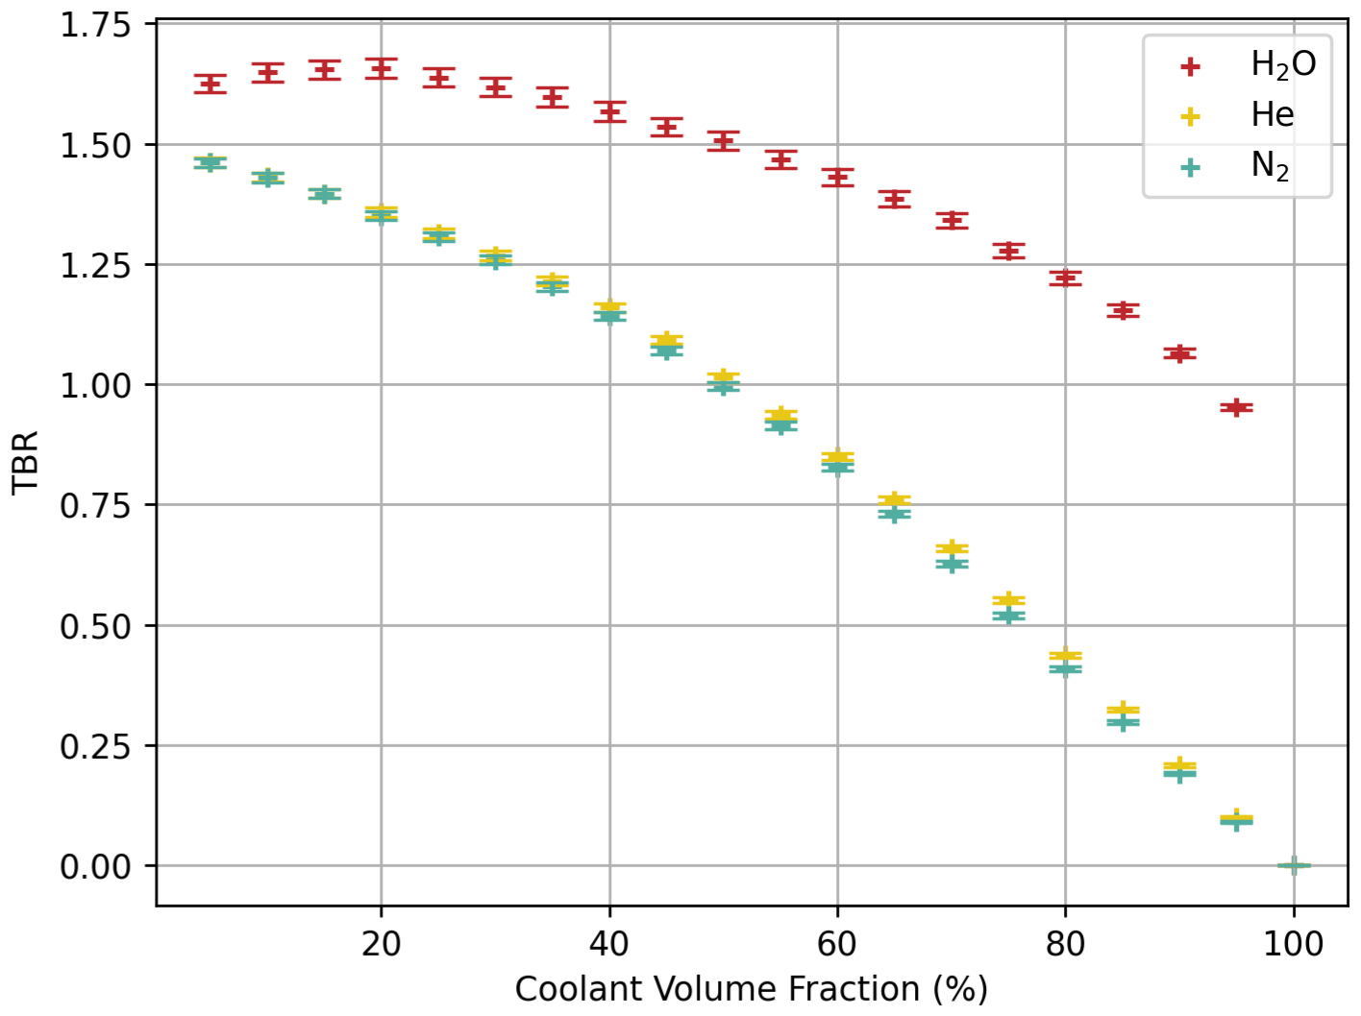
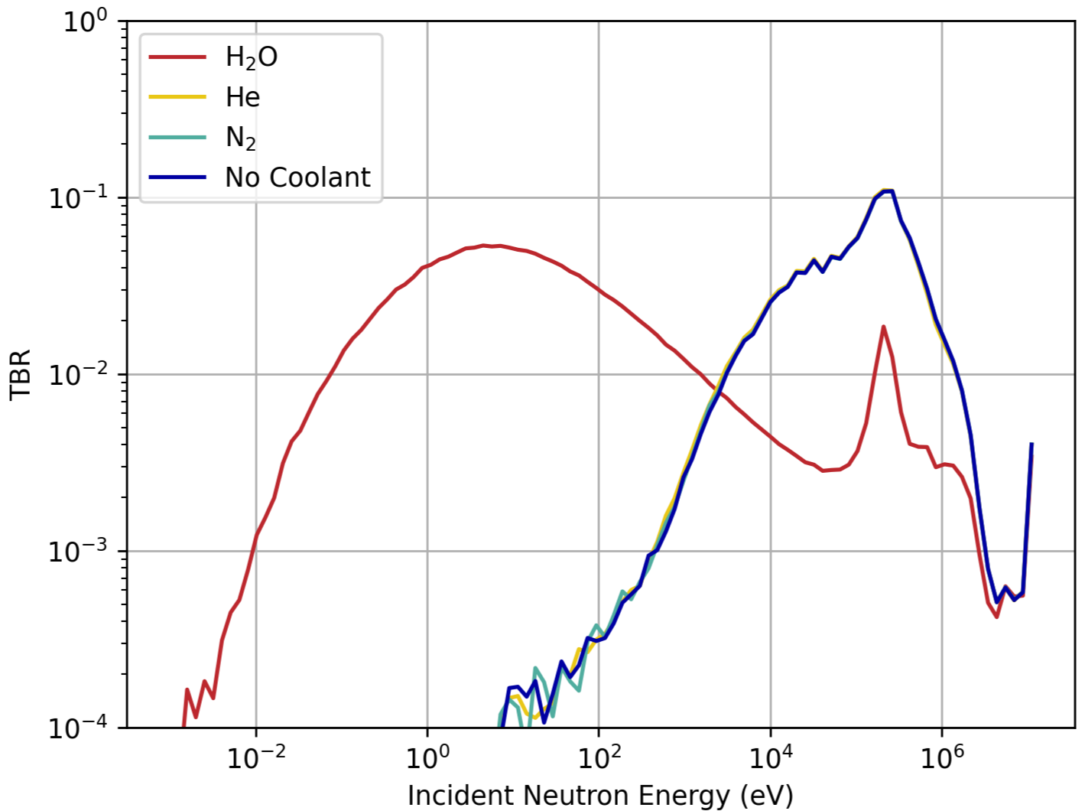
Coolant Fraction and Choice
Tbr / coolant fraction
Neutron energy for the TBR reactions
Water was found to be far superior for TBR, Heating and low neutron leakage as it can act as a moderator.
However, one must weigh this with the safety consideration of Lithium and Water in close proximity + be wary of the homogenous approximation

Slide 13
Limitations & Next Steps
Homogenous assumption → Heterogenous Blanket Upgrade
Plasma Ring Source → Plasma Body Source with Density Variation
Simplified Tokamak Geometry → Complex Structure more closely matched to Real Devices
Focus on TBR → Holistic consideration for Heating + Safety (Minimise Leakage Fractions).

